Slide 1
Lecture 19
Flow Algorithms

Slide 2
4
6
10
8
8
6
6
10
10
8
8

Slide 3
4
6
10
8
8
6
6
10
10
8
8

Slide 4

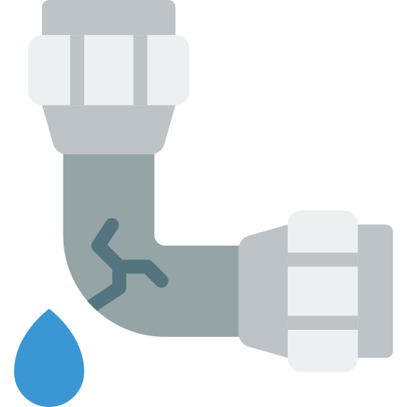

Not enough water:
not the best performance
Too much water:
not enough capacity to support

Slide 5
You want to find the maximum amount of flow you can send without exceeding the capacity of any pipe

Slide 6
s
t
source
sink

Slide 7
A
C
E
s
t
source
sink
B
D
F

Slide 8
A
C
E
s
t
source
sink
B
D
F

Slide 9
A
C
E
4
6
10
8
8
s
t
6
source
sink
10
6
10
8
8
B
D
F

Slide 10
A
C
E
4
6
10
8
8
s
t
6
source
sink
10
6
10
8
8
B
D
F
From this graph, we want to find the maximum feasible flow. A flow is a mapping from edges to real numbers, we assign a flow value to each edge

Slide 11
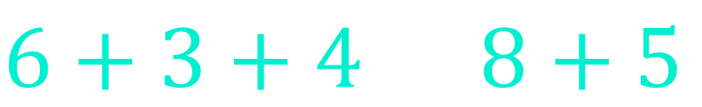
From this graph, we want to find the maximum feasible flow. A flow is a mapping from edges to real numbers, we assign a flow value to each edge
A flow is feasible if:
For each edge, the assigned flow doesn't exceed its maximum capacity
For each edge, the amount of flow entering it is equal to the amount of flow leaving it
Example:
6/10
8/8
3/8
C
$$6+3+4=8+5$$
5/10
4/7

Slide 12

A
4/4
C
4/6
E
10/10
8/8
s
6/8
t
6/6
2/6
8/10
10/10
B
D
F
8/8
8/8
The total amount of this flow is $18 (f(sA)+f(sB)=10+8=18)$, it's the maximum flow because we cannot find another flow with a total amount greater than $18$

Slide 13
Input: flow network
A
C
E
4
6
10
8
8
s
t
6
10
6
10
8
8
B
D
F

Slide 14
Input: flow network
A
C
E
4
6
10
8
s
8
t
6
We build a residual graph:
10
6
10
B
8
D
8
F
A
C
E
s
t
B
D
F

Slide 15
Input: flow network
A
C
E
4
6
10
8
s
8
t
6
We build a residual graph:
10
6
10
B
8
D
8
F
A
C
E
s
t
B
D
F

Slide 16
Input: flow network
A
C
E
4
6
10
8
s
8
t
6
We build a residual graph:
10
6
10
B
8
D
8
F
A
C
E
s
t
B
D
F

Slide 17
Input: flow network
A
C
E
4
6
10
8
s
8
t
6
We build a residual graph:
10
6
10
B
8
D
8
F
A
C
E
The residual graph stores the remaining capacity of each edge
Initially, the remaining capacity of a forward edge is its maximum capacity
Initially, the remaining capacity of a backward edge is 0
s
t
B
D
F

Slide 18
Input: flow network
A
C
E
4
6
10
8
s
8
t
6
We build a residual graph:
10
6
10
B
8
D
8
F
A
C
E
4
6
The residual graph stores the remaining capacity of each edge
Initially, the remaining capacity of a forward edge is its maximum capacity
Initially, the remaining capacity of a backward edge is 0
10
8
8
s
6
t
10
6
10
B
8
D
8
F

Slide 19
Input: flow network
A
C
E
4
6
10
8
s
8
t
6
We build a residual graph:
10
6
10
B
8
D
8
F
0
0
A
C
E
4
6
0
0
The residual graph stores the remaining capacity of each edge
Initially, the remaining capacity of a forward edge is its maximum capacity
Initially, the remaining capacity of a backward edge is 0
10
8
8
0
s
6
t
0
0
10
6
10
0
0
B
8
D
8
F
0
0

Slide 20
In general, the remaining capacity of a forward edge is its maximum capacityy minus how much flow is pushed through it, and the capacity of a backward edge is how much flow is pushed through its forward edge
Example:
If the maximum capacity of AD is 8 and we pushed an amount of 3, then remaining capacity of AD is 5 (8-3), and remaining capacity of DA is 3
In input:
A
In residual graph:
8
A
D
5
3
D

Slide 21
There exists multiple algorithms to solve the maximum flow problem, such as Ford-Fulkerson algorithm, Edmonds-Karp algorithm, and Dinic's algorithm

Slide 22
min-cut max-flow theorem

Slide 23
min-cut max-flow theorem
A
C
E
4
6
10
8
8
s
6
t
10
6
10
B
8
D
8
F

Slide 24


min-cut max-flow theorem
A
C
E
4
6
10
8
8
s
6
t
10
6
10
B
8
D
8
F
We can disconnect the graph by removing some edges, for example $\{AC, AD, BD\}$. Such a set is named a cut

Slide 25

min-cut max-flow theorem
A
C
E
4
6
10
8
8
s
6
t
10
6
10
B
8
D
8
F
Cuts have different total weights, for example $\{AC, AD, BD\}$ had a total weight of $20 (4+8+8)$. The cut with the smallest total weight is the minimum cut. In this example it's $\{Et, Ft\}$, with a total weight of $18 (8+10)$

Slide 26

min-cut max-flow theorem
:
In a flow network, the maximum amount of flow passing from $s$ to $t$, is equal to total weight of edges of the minimum cut

Slide 27
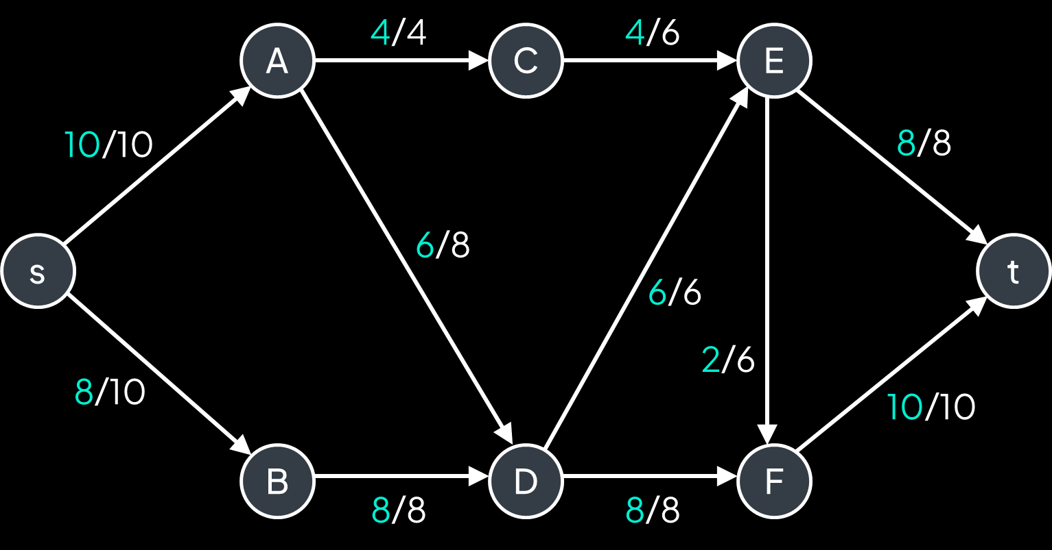
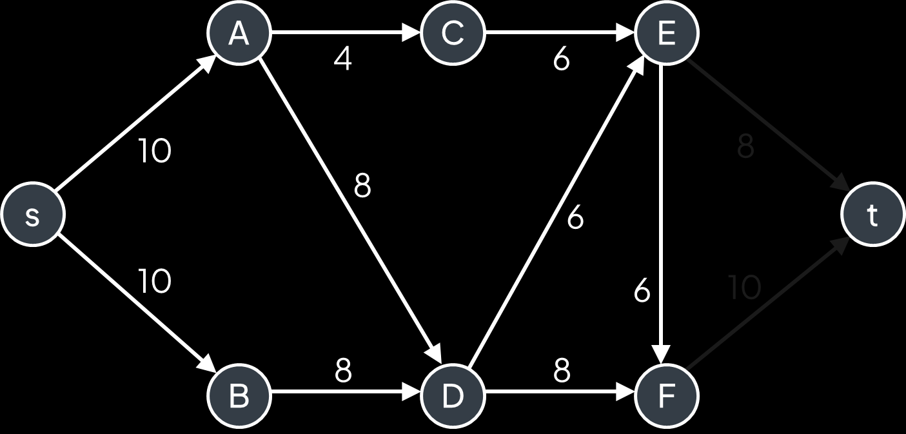

min-cut max-flow theorem
:
In a flow network, the maximum amount of flow passing from $s$ to $t$, is equal to total weight of edges of the minimum cut
In our example, the maximum amount of flow is 18, and the total weight of the minimum cut is also 18
8
10
Maximum amount flow is 18
Total weight of the minimum cut is 18

Slide 28
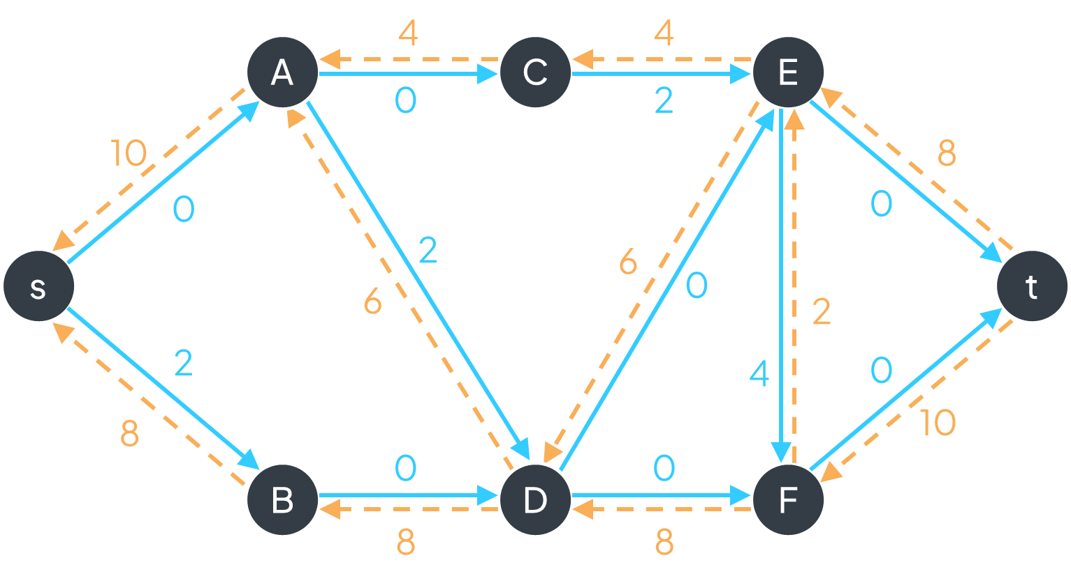
Ford-Fulkerson
algorithm

Slide 29
maximum capacity
0/10
capacity used (flow)
A
D
0/10
0/10
s
0/10
t
0/10
0/10
B
C
0/10

Slide 30
maximum capacity
0/10
capacity used (flow)
A
D
0/10
0/10
s
0/10
t
0/10
0/10
B
C
0/10

Slide 31
maximum capacity
0/10
capacity used (flow)
A
D
0/10
10/10
s
10/10
t
0/10
10/10
B
C
0/10

Slide 32
maximum capacity
0/10
capacity used (flow)
A
D
0/10
10/10
s
10/10
t
0/10
10/10
B
C
0/10

Slide 33
maximum capacity
0/10
capacity used (flow)
A
D
0/10
10/10
s
10/10
t
0/10
10/10
B
C
0/10

Slide 34
maximum capacity
0/10
capacity used (flow)
A
D
0/10
10/10
s
10/10
t
0/10
10/10
B
C
We cannot continue further because Ct is full
0/10

Slide 35
maximum capacity
0/10
capacity used (flow)
A
D
0/10
10/10
s
10/10
t
0/10
10/10
B
C
But we can relocate path1 to exploit other available edges and let path2 continue to t
0/10

Slide 36
maximum capacity
10/10
capacity used (flow)
A
D
10/10
10/10
s
0/10
t
10/10
10/10
B
C
But we can relocate path1 to exploit other available edges and let path2 continue to t
10/10

Slide 37
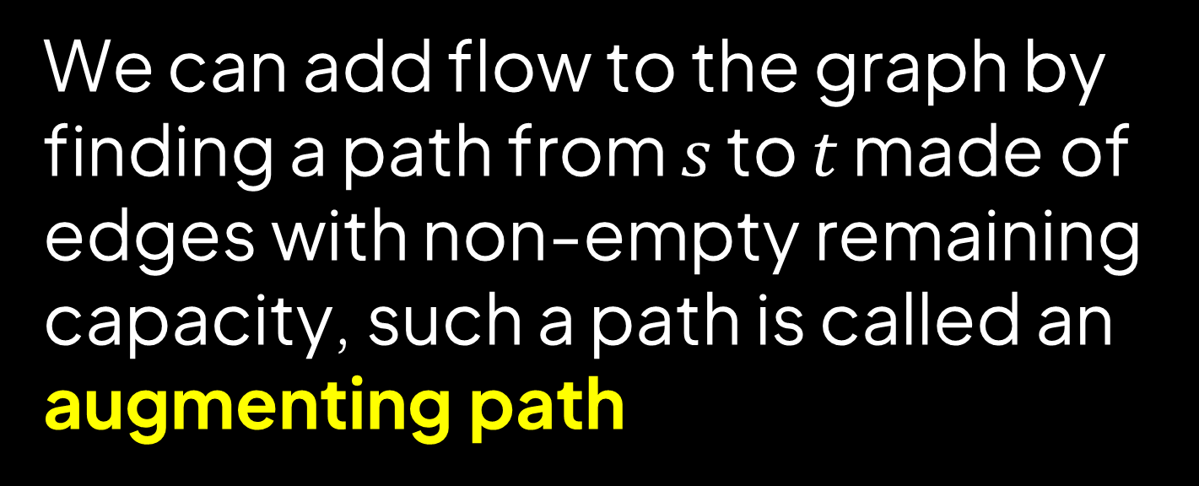
We can add flow to the graph by finding a path from $s$ to $t$ made of edges with non-empty remaining capacity, such a path is called an augmenting path

Slide 38
A
10
0
B

Slide 39
We add a flow of 3 through AB, capacity of AB decreases by 3 and capacity of BA increases by 3
A
-3
10
0
+3
B

Slide 40
We add a flow of 3 through AB, capacity of AB decreases by 3 and capacity of BA increases by 3
A
7
3
B

Slide 41
We add a flow of 5 through AB, capacity of AB decreases by 5 and capacity of BA increases by 5
A
-5
7
3
+5
B

Slide 42
We add a flow of 5 through AB, capacity of AB decreases by 5 and capacity of BA increases by 5
A
2
8
B

Slide 43
We add a flow of 4 through BA, capacity of BA decreases by 4 and capacity of AB increases by 4
A
+4
2
8
-4
B

Slide 44
We add a flow of 4 through BA, capacity of BA decreases by 4 and capacity of AB increases by 4
A
6
4
B

Slide 45
0
0
A
C
E
4
6
0
0
10
8
8
0
s
6
t
0
0
10
6
10
0
0
8
8
B
D
F
0
0

Slide 46

0
0
A
C
E
4
6
0
bottleneck capacity
0
10
8
8
0
s
6
t
0
0
10
6
10
0
0
8
8
B
D
F
0
0
$$bottleneck\left(p\right)=\min_{e ∈ p}{e.capacity} \\ =\min\left(10, 4, 6, 6, 10\right)=4$$

Slide 47
+4
+4
4
4
A
C
E
0
2
+4
-4
-4
4
0
6
8
-4
8
s
0
t
0
6
+4
4
-4
10
2
6
-4
0
4
8
8
+4
B
D
F
0
0
$$bottleneck\left(p\right)=\min_{e ∈ p}{e.capacity} \\ =\min\left(10, 4, 6, 6, 10\right)=4$$

Slide 48

Ford-Fulkerson algorithm:
$$total_flow←0 \\ while true: \\ p←find_augmenting_path\left(residual_g\right) \\ if p is null: \\ break \\ bottleneck←\min_{e ∈ p}{e.capacity} \\ total_flow←total_flow+bottleneck \\ for \left(u,v\right)∈p: \\ residual_g\left[u\right]\left[v\right]←residual_g\left[u\right]\left[v\right]−bottleneck \\ residual_g\left[v\right]\left[u\right]←residual_g\left[v\right]\left[u\right]+bottleneck \\ return total_flow$$

Slide 49
Ford-Fulkerson algorithm:
$$total_flow←0 \\ while true: \\ p←find_augmenting_path\left(residual_g\right) \\ if p is null: \\ break \\ bottleneck←\min_{e ∈ p}{e.capacity} \\ total_flow←total_flow+bottleneck \\ for \left(u,v\right)∈p: \\ residual_g\left[u\right]\left[v\right]←residual_g\left[u\right]\left[v\right]−bottleneck \\ residual_g\left[v\right]\left[u\right]←residual_g\left[v\right]\left[u\right]+bottleneck \\ return total_flow$$
dfs?

Slide 50
0
0
A
C
E
4
6
0
0
10
8
8
0
s
6
t
0
0
10
6
10
0
0
8
8
B
D
F
0
0
Augmenting paths:

Slide 51
0
0
A
C
E
4
6
0
0
10
8
8
0
s
6
t
0
0
10
6
10
0
0
8
8
B
D
F
0
0
Augmenting paths:

Slide 52
0
0
A
C
E
4
6
0
0
10
8
8
0
s
6
t
0
0
10
6
10
0
0
8
8
B
D
F
0
0
Augmenting paths:

Slide 53
0
0
A
C
E
4
6
0
0
10
8
8
0
s
6
t
0
0
10
6
10
0
0
8
8
B
D
F
0
0
Augmenting paths:

Slide 54
0
0
A
C
E
4
6
0
0
10
8
8
0
s
6
t
0
0
10
6
10
0
0
8
8
B
D
F
0
0
Augmenting paths:

Slide 55
0
0
A
C
E
4
6
0
0
10
8
8
0
s
6
t
0
0
10
6
10
0
0
8
8
B
D
F
0
0
Augmenting paths:

Slide 56
0
0
A
C
E
4
6
0
0
10
8
8
0
s
6
t
0
0
10
6
10
0
0
8
8
B
D
F
0
0
Augmenting paths:

Slide 57
0
0
A
C
E
4
6
0
0
10
8
8
0
s
6
t
0
0
10
6
10
0
0
8
8
B
D
F
0
0
Augmenting paths:

Slide 58
0
0
A
C
E
4
6
0
0
10
8
8
0
s
6
t
0
0
10
6
10
0
0
8
8
B
D
F
0
0
Augmenting paths:

Slide 59
0
0
A
C
E
4
6
0
0
10
8
8
0
s
6
t
0
0
10
6
10
0
0
8
8
B
D
F
0
0
Augmenting paths:
sACEFt (bottleneck = 4)

Slide 60
0
0
A
C
E
4
6
+4
4
0
-4
6
8
8
0
s
6
t
0
0
10
6
10
0
0
8
8
B
D
F
0
0
Augmenting paths:
sACEFt (bottleneck = 4)

Slide 61
+4
4
0
A
C
E
0
6
-4
4
0
6
8
8
0
s
6
t
0
0
10
6
10
0
0
8
8
B
D
F
0
0
Augmenting paths:
sACEFt (bottleneck = 4)

Slide 62
+4
4
4
A
C
E
0
2
-4
4
0
6
8
8
0
s
6
t
0
0
10
6
10
0
0
8
8
B
D
F
0
0
Augmenting paths:
sACEFt (bottleneck = 4)

Slide 63
4
4
A
C
E
0
2
4
0
6
8
8
0
s
6
t
0
4
+4
10
2
10
-4
0
0
8
8
B
D
F
0
0
Augmenting paths:
sACEFt (bottleneck = 4)

Slide 64
4
4
A
C
E
0
2
4
0
6
8
8
0
s
6
t
0
4
-4
10
2
6
0
4
8
8
+4
B
D
F
0
0
Augmenting paths:
sACEFt (bottleneck = 4)

Slide 65
4
4
A
C
E
0
2
4
0
6
8
8
0
s
6
t
0
4
10
2
6
0
4
8
8
B
D
F
0
0
Augmenting paths:
sACEFt (bottleneck = 4)

Slide 66
4
4
A
C
E
0
2
4
0
6
8
8
0
s
6
t
0
4
10
2
6
0
4
8
8
B
D
F
0
0
Augmenting paths:
sACEFt (bottleneck = 4)

Slide 67
4
4
A
C
E
0
2
4
0
6
8
8
0
s
6
t
0
4
10
2
6
0
4
8
8
B
D
F
0
0
Augmenting paths:
sACEFt (bottleneck = 4)

Slide 68
4
4
A
C
E
0
2
4
0
6
8
8
0
s
6
t
0
4
10
2
6
0
4
8
8
B
D
F
0
0
Augmenting paths:
sACEFt (bottleneck = 4)

Slide 69
4
4
A
C
E
0
2
4
0
6
8
8
0
s
6
t
0
4
10
2
6
0
4
8
8
B
D
F
0
0
Augmenting paths:
sACEFt (bottleneck = 4)

Slide 70
4
4
A
C
E
0
2
4
0
6
8
8
0
s
6
t
0
4
10
2
6
0
4
8
8
B
D
F
0
0
Augmenting paths:
sACEFt (bottleneck = 4)

Slide 71
4
4
A
C
E
0
2
4
0
6
8
8
0
s
6
t
0
4
10
2
6
0
4
8
8
B
D
F
0
0
Augmenting paths:
sACEFt (bottleneck = 4)
sADFt (bottleneck = 6)

Slide 72
4
4
A
C
E
0
2
+6
10
0
0
8
-6
-6
2
0
s
6
t
6
4
+6
-6
10
2
0
0
10
-6
+6
8
2
B
D
F
0
6
+6
Augmenting paths:
sACEFt (bottleneck = 4)
sADFt (bottleneck = 6)

Slide 73
4
4
A
C
E
0
2
10
0
0
8
2
0
s
6
t
6
4
10
2
0
0
10
8
2
B
D
F
0
6
Augmenting paths:
sACEFt (bottleneck = 4)
sADFt (bottleneck = 6)

Slide 74
4
4
A
C
E
0
2
10
0
0
8
2
0
s
6
t
6
4
10
2
0
0
10
8
2
B
D
F
0
6
Augmenting paths:
sACEFt (bottleneck = 4)
sADFt (bottleneck = 6)

Slide 75
4
4
A
C
E
0
2
10
0
0
8
2
0
s
6
t
6
4
10
2
0
0
10
8
2
B
D
F
0
6
Augmenting paths:
sACEFt (bottleneck = 4)
sADFt (bottleneck = 6)

Slide 76
4
4
A
C
E
0
2
10
0
0
8
2
0
s
6
t
6
4
10
2
0
0
10
8
2
B
D
F
0
6
Augmenting paths:
sACEFt (bottleneck = 4)
sADFt (bottleneck = 6)

Slide 77
4
4
A
C
E
0
2
10
0
0
8
2
0
s
6
t
6
4
10
2
0
0
10
8
2
B
D
F
0
6
Augmenting paths:
sACEFt (bottleneck = 4)
sADFt (bottleneck = 6)

Slide 78
4
4
A
C
E
0
2
10
0
0
8
2
0
s
6
t
6
4
10
2
0
0
10
8
2
B
D
F
0
6
Augmenting paths:
sACEFt (bottleneck = 4)
sADFt (bottleneck = 6)

Slide 79
4
4
A
C
E
0
2
10
0
0
8
2
0
s
6
t
6
4
10
2
0
0
10
8
2
B
D
F
0
6
Augmenting paths:
sACEFt (bottleneck = 4)
sADFt (bottleneck = 6)
sBDFEt (bottleneck = 2)

Slide 80
4
4
A
C
E
0
2
+2
10
2
0
6
-2
2
0
s
6
t
6
-2
2
-2
8
4
0
+2
2
10
-2
-2
+2
6
0
B
D
F
2
8
+2
+2
Augmenting paths:
sACEFt (bottleneck = 4)
sADFt (bottleneck = 6)
sBDFEt (bottleneck = 2)

Slide 81
4
4
A
C
E
0
2
10
2
0
6
2
0
s
6
t
6
2
8
4
0
2
10
6
0
B
D
F
2
8
Augmenting paths:
sACEFt (bottleneck = 4)
sADFt (bottleneck = 6)
sBDFEt (bottleneck = 2)

Slide 82
4
4
A
C
E
0
2
10
2
0
6
2
0
s
6
t
6
2
8
4
0
2
10
6
0
B
D
F
2
8
Augmenting paths:
sACEFt (bottleneck = 4)
sADFt (bottleneck = 6)
sBDFEt (bottleneck = 2)

Slide 83
4
4
A
C
E
0
2
10
2
0
6
2
0
s
6
t
6
2
8
4
0
2
10
6
0
B
D
F
2
8
Augmenting paths:
sACEFt (bottleneck = 4)
sADFt (bottleneck = 6)
sBDFEt (bottleneck = 2)

Slide 84
4
4
A
C
E
0
2
10
2
0
6
2
0
s
6
t
6
2
8
4
0
2
10
6
0
B
D
F
2
8
Augmenting paths:
sACEFt (bottleneck = 4)
sADFt (bottleneck = 6)
sBDFEt (bottleneck = 2)

Slide 85
4
4
A
C
E
0
2
10
2
0
6
2
0
s
6
t
6
2
8
4
0
2
10
6
0
B
D
F
2
8
Augmenting paths:
sACEFt (bottleneck = 4)
sADFt (bottleneck = 6)
sBDFEt (bottleneck = 2)

Slide 86
4
4
A
C
E
0
2
10
2
0
6
2
0
s
6
t
6
2
8
4
0
2
10
6
0
B
D
F
2
8
Augmenting paths:
sACEFt (bottleneck = 4)
sADFt (bottleneck = 6)
sBDFEt (bottleneck = 2)
sBDEt (bottleneck = 6)

Slide 87
4
4
A
C
E
0
2
+6
10
8
0
0
2
+6
-6
s
6
t
6
0
-6
2
-6
2
4
0
8
10
-6
+6
0
0
B
D
F
8
8
+6
Augmenting paths:
sACEFt (bottleneck = 4)
sADFt (bottleneck = 6)
sBDFEt (bottleneck = 2)
sBDEt (bottleneck = 6)

Slide 88
4
4
A
C
E
0
2
10
8
0
0
2
6
s
0
t
6
2
2
4
0
8
10
0
0
B
D
F
8
8
Augmenting paths:
sACEFt (bottleneck = 4)
sADFt (bottleneck = 6)
sBDFEt (bottleneck = 2)
sBDEt (bottleneck = 6)

Slide 89
4
4
A
C
E
0
2
10
8
0
0
2
6
s
0
t
6
2
2
4
0
8
10
0
0
B
D
F
8
8
Augmenting paths:
sACEFt (bottleneck = 4)
sADFt (bottleneck = 6)
sBDFEt (bottleneck = 2)
sBDEt (bottleneck = 6)

Slide 90




4
4
Augmenting paths:
A
C
E
0
2
10
8
sACEFt (bottleneck = 4)
0
0
$$+$$
2
sADFt (bottleneck = 6)
s
6
t
6
0
2
$$+$$
sBDFEt (bottleneck = 2)
2
4
0
maximum flow
10
$$+$$
8
sBDEt (bottleneck = 6)
0
0
B
D
F
$$=18$$
8
8

Slide 91
def dfs(residual, u, sink, path, visited):
if u == sink:
return path
visited.add(u)
for v in residual[u]:
if v not in visited and residual[u][v] > 0:
path.append((u, v))
if dfs(residual, v, sink, path, visited):
return path
path.pop()
return None

Slide 92
0
0
A
C
E
4
6
0
0
10
8
s
8
0
t
0
6
0
10
6
10
0
0
B
8
D
8
F
{
's': {'A': 10, 'B': 10},
'A': {'C': 4, 'D': 8, 's': 0},
'B': {'D': 8, 's': 0},
'C': {'E': 6, 'A': 0},
'D': {'E': 6, 'F': 8, 'A': 0, 'B': 0},
'E': {'F': 6, 't': 8, 'C': 0, 'D': 0},
'F': {'t': 10, 'D': 0, 'E': 0},
't': {'E': 0, 'F': 0}
}
0
0

Slide 93
def dfs(residual, u, sink, path, visited):
if u == sink:
return path
visited.add(u)
for v in residual[u]:
if v not in visited and residual[u][v] > 0:
path.append((u, v))
if dfs(residual, v, sink, path, visited):
return path
path.pop()
return None

Slide 94
def ford_fulkerson(graph):
residual = defaultdict(lambda: {})
for u in graph:
for v, w in graph[u]:
residual[u][v] = w
residual[v][u] = 0
total_flow = 0
while True:
path = dfs(residual, 's', 't', [], set())
if path is None:
break
bottleneck = min(residual[u][v] for u, v in path)
total_flow += bottleneck
for u, v in path:
residual[u][v] -= bottleneck
residual[v][u] += bottleneck
return total_flow

Slide 95
def ford_fulkerson(graph):
residual = defaultdict(lambda: {})
for u in graph:
for v, w in graph[u]:
residual[u][v] = w
residual[v][u] = 0
total_flow = 0
while True:
path = dfs(residual, 's', 't', [], set())
if path is None:
break
bottleneck = min(residual[u][v] for u, v in path)
total_flow += bottleneck
for u, v in path:
residual[u][v] -= bottleneck
residual[v][u] += bottleneck
return total_flow
$$|E|$$

Slide 96

def ford_fulkerson(graph):
residual = defaultdict(lambda: {})
for u in graph:
for v, w in graph[u]:
residual[u][v] = w
residual[v][u] = 0
total_flow = 0
while True:
path = dfs(residual, 's', 't', [], set())
if path is None:
break
bottleneck = min(residual[u][v] for u, v in path)
total_flow += bottleneck
for u, v in path:
residual[u][v] -= bottleneck
residual[v][u] += bottleneck
return total_flow
$$?$$
$$|E|$$

Slide 97
Augmenting paths:
A
0
0
10000
10000
s
t
1
0
10000
10000
0
0
B

Slide 98
Augmenting paths:
A
sABt (bottleneck = 1)
0
0
10000
10000
s
t
1
0
10000
10000
0
0
B

Slide 99
Augmenting paths:
A
sABt (bottleneck = 1)
+1
1
0
9999
10000
s
-1
+1
t
0
-1
1
-1
10000
9999
0
1
B
+1

Slide 100
Augmenting paths:
A
sABt (bottleneck = 1)
sBAt (bottleneck = 1)
1
0
9999
10000
s
t
0
1
10000
9999
0
1
B

Slide 101
Augmenting paths:
A
sABt (bottleneck = 1)
+1
sBAt (bottleneck = 1)
1
1
9999
9999
s
-1
-1
t
1
+1
0
-1
9999
9999
1
1
+1
B

Slide 102
Augmenting paths:
A
sABt (bottleneck = 1)
sBAt (bottleneck = 1)
1
1
sABt (bottleneck = 1)
9999
9999
s
t
1
0
9999
9999
1
1
B

Slide 103
Augmenting paths:
A
sABt (bottleneck = 1)
+1
sBAt (bottleneck = 1)
2
1
sABt (bottleneck = 1)
9998
9999
s
-1
+1
t
0
-1
1
-1
9999
9998
1
2
B
+1

Slide 104
Augmenting paths:
A
sABt (bottleneck = 1)
sBAt (bottleneck = 1)
2
1
sABt (bottleneck = 1)
9998
9999
sBAt (bottleneck = 1)
s
t
0
1
9999
9998
1
2
B

Slide 105
Augmenting paths:
A
sABt (bottleneck = 1)
+1
sBAt (bottleneck = 1)
2
2
sABt (bottleneck = 1)
9998
9998
sBAt (bottleneck = 1)
s
-1
-1
t
1
+1
0
-1
9998
9998
2
2
+1
B

Slide 106
Augmenting paths:
A
sABt (bottleneck = 1)
sBAt (bottleneck = 1)
9999
9999
sABt (bottleneck = 1)
1
1
sBAt (bottleneck = 1)
s
t
1
.
.
.
0
1
1
9999
9999
B

Slide 107
Augmenting paths:
A
sABt (bottleneck = 1)
sBAt (bottleneck = 1)
9999
9999
sABt (bottleneck = 1)
1
1
sBAt (bottleneck = 1)
s
t
1
.
.
.
0
1
1
9999
9999
sABt (bottleneck = 1)
B

Slide 108
Augmenting paths:
A
sABt (bottleneck = 1)
+1
sBAt (bottleneck = 1)
10000
9999
sABt (bottleneck = 1)
0
1
sBAt (bottleneck = 1)
s
-1
+1
t
0
.
.
.
-1
1
-1
1
0
9999
10000
sABt (bottleneck = 1)
B
+1

Slide 109
Augmenting paths:
A
sABt (bottleneck = 1)
sBAt (bottleneck = 1)
10000
9999
sABt (bottleneck = 1)
0
1
sBAt (bottleneck = 1)
s
t
0
.
.
.
1
1
0
9999
10000
sABt (bottleneck = 1)
B
sBAt (bottleneck = 1)

Slide 110
Augmenting paths:
A
sABt (bottleneck = 1)
+1
sBAt (bottleneck = 1)
10000
10000
sABt (bottleneck = 1)
0
0
sBAt (bottleneck = 1)
s
-1
-1
t
1
.
.
.
+1
0
-1
0
0
10000
10000
sABt (bottleneck = 1)
+1
B
sBAt (bottleneck = 1)

Slide 111
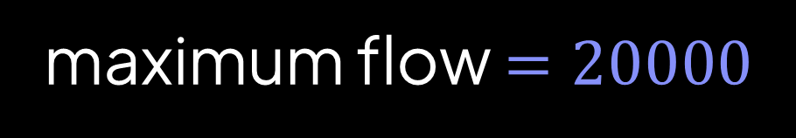
Augmenting paths:
A
sABt (bottleneck = 1)
sBAt (bottleneck = 1)
10000
10000
sABt (bottleneck = 1)
0
0
sBAt (bottleneck = 1)
s
t
1
.
.
.
0
0
0
10000
10000
sABt (bottleneck = 1)
B
sBAt (bottleneck = 1)
maximum flow $=20000$
and we did 20000 iterations

Slide 112

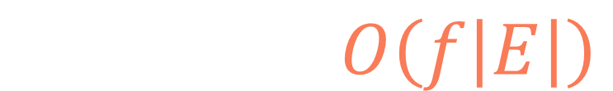

def ford_fulkerson(graph):
residual = defaultdict(lambda: {})
for u in graph:
for v, w in graph[u]:
residual[u][v] = w
residual[v][u] = 0
total_flow = 0
while True:
path = dfs(residual, 's', 't', [], set())
if path is None:
break
bottleneck = min(residual[u][v] for u, v in path)
total_flow += bottleneck
for u, v in path:
residual[u][v] -= bottleneck
residual[v][u] += bottleneck
return total_flow
$f=$ max flow
$$T\left(V,E\right)=O\left(f\left|E\right|\right)$$
$$f$$
$$|E|$$

Slide 113
Edmonds-Karp
algorithm

Slide 114
def ford_fulkerson(graph):
residual = defaultdict(lambda: {})
for u in graph:
for v, w in graph[u]:
residual[u][v] = w
residual[v][u] = 0
total_flow = 0
while True:
path = dfs(residual, 's', 't', [], set())
if path is None:
break
bottleneck = min(residual[u][v] for u, v in path)
total_flow += bottleneck
for u, v in path:
residual[u][v] -= bottleneck
residual[v][u] += bottleneck
return total_flow

Slide 115
def ford_fulkerson(graph):
residual = defaultdict(lambda: {})
for u in graph:
for v, w in graph[u]:
residual[u][v] = w
residual[v][u] = 0
total_flow = 0
while True:
path = dfs(residual, 's', 't', [], set())
if path is None:
break
bottleneck = min(residual[u][v] for u, v in path)
total_flow += bottleneck
for u, v in path:
residual[u][v] -= bottleneck
residual[v][u] += bottleneck
return total_flow
bfs

Slide 116
queue
vertex
0
0
A
C
E
4
6
0
0
10
8
8
0
s
6
t
0
0
10
6
10
0
0
B
8
D
8
F
0
0
Augmenting paths:

Slide 117
queue
vertex
0
0
s
A
C
E
4
6
0
0
10
8
8
0
s
6
t
0
0
10
6
10
0
0
B
8
D
8
F
0
0
Augmenting paths:

Slide 118
queue
vertex
0
0
s
A
C
E
4
6
0
0
10
8
8
0
s
6
t
0
0
10
6
10
0
0
B
8
D
8
F
0
0
Augmenting paths:

Slide 119

queue
vertex
s
0
0
A
s
A
C
E
B
4
6
0
0
10
8
8
0
s
6
t
0
0
10
6
10
0
0
B
8
D
8
F
0
0
prev
s
$$u$$
: visited
Augmenting paths:

Slide 120
queue
vertex
s
0
0
B
A
A
C
E
4
6
0
0
10
8
8
0
s
6
t
0
0
10
6
10
0
0
B
8
D
8
F
0
0
prev
s
$$u$$
: visited
Augmenting paths:

Slide 121
queue
vertex
s
A
0
0
B
A
A
C
E
C
4
6
D
0
0
10
8
8
0
s
6
t
0
0
10
6
10
0
0
B
8
D
8
F
0
0
prev
s
A
$$u$$
: visited
Augmenting paths:

Slide 122
queue
vertex
s
A
0
0
C
B
A
C
E
D
4
6
0
0
10
8
8
0
s
6
t
0
0
10
6
10
0
0
B
8
D
8
F
0
0
prev
s
A
$$u$$
: visited
Augmenting paths:

Slide 123
queue
vertex
s
A
0
0
D
C
A
C
E
4
6
0
0
10
8
8
0
s
6
t
0
0
10
6
10
0
0
B
8
D
8
F
0
0
prev
s
A
$$u$$
: visited
Augmenting paths:

Slide 124
queue
vertex
s
A
C
0
0
D
C
A
C
E
E
4
6
0
0
10
8
8
0
s
6
t
0
0
10
6
10
0
0
B
8
D
8
F
0
0
prev
s
A
$$u$$
: visited
Augmenting paths:

Slide 125
queue
vertex
s
A
C
0
0
E
D
A
C
E
4
6
0
0
10
8
8
0
s
6
t
0
0
10
6
10
0
0
B
8
D
8
F
0
0
prev
s
A
$$u$$
: visited
Augmenting paths:

Slide 126
queue
vertex
s
A
C
0
0
E
D
A
C
E
F
4
6
0
0
10
8
8
0
s
6
t
0
0
10
6
10
0
0
B
8
D
8
F
0
0
prev
s
A
D
$$u$$
: visited
Augmenting paths:

Slide 127
queue
vertex
s
A
C
0
0
F
E
A
C
E
4
6
0
0
10
8
8
0
s
6
t
0
0
10
6
10
0
0
B
8
D
8
F
0
0
prev
s
A
D
$$u$$
: visited
Augmenting paths:

Slide 128
queue
vertex
s
A
C
0
0
F
E
A
C
E
t
4
6
0
0
10
8
E
8
0
s
6
t
0
0
10
6
10
0
0
B
8
D
8
F
0
0
prev
s
A
D
$$u$$
: visited
Augmenting paths:

Slide 129
queue
vertex
s
A
C
0
0
t
F
A
C
E
4
6
0
0
10
8
E
8
0
s
6
t
0
0
10
6
10
0
0
B
8
D
8
F
0
0
prev
s
A
D
$$u$$
: visited
Augmenting paths:

Slide 130
queue
vertex
s
A
C
0
0
t
A
C
E
4
6
0
0
10
8
E
8
0
s
6
t
0
0
10
6
10
0
0
B
8
D
8
F
0
0
prev
s
A
D
$$u$$
: visited
Augmenting paths:

Slide 131
queue
vertex
s
A
C
0
0
A
C
E
4
6
0
0
10
8
E
8
0
s
6
t
0
0
10
6
10
0
0
B
8
D
8
F
0
0
prev
s
A
D
$$u$$
: visited
Augmenting paths:
sACEt (bottleneck = 4)

Slide 132
queue
vertex
s
+4
A
+4
C
4
4
A
C
E
0
2
+4
-4
-4
+4
4
4
6
4
E
-4
-4
8
0
s
6
t
0
0
10
6
10
0
0
B
8
D
8
F
0
0
prev
s
A
D
$$u$$
: visited
Augmenting paths:
sACEt (bottleneck = 4)

Slide 133
queue
vertex
4
4
A
C
E
0
2
4
4
6
4
8
0
s
6
t
0
0
10
6
10
0
0
B
8
D
8
F
0
0
prev
$$u$$
: visited
Augmenting paths:
sACEt (bottleneck = 4)

Slide 134
queue
vertex
4
4
s
A
C
E
0
2
4
4
6
4
8
0
s
6
t
0
0
10
6
10
0
0
B
8
D
8
F
0
0
prev
$$u$$
: visited
Augmenting paths:
sACEt (bottleneck = 4)

Slide 135
queue
vertex
4
4
s
A
C
E
0
2
4
4
6
4
8
0
s
6
t
0
0
10
6
10
0
0
B
8
D
8
F
0
0
prev
$$u$$
: visited
Augmenting paths:
sACEt (bottleneck = 4)

Slide 136
queue
vertex
s
4
4
A
s
A
C
E
B
0
2
4
4
6
4
8
0
s
6
t
0
0
10
6
10
0
0
B
8
D
8
F
0
0
prev
s
$$u$$
: visited
Augmenting paths:
sACEt (bottleneck = 4)

Slide 137
queue
vertex
s
4
4
B
A
A
C
E
0
2
4
4
6
4
8
0
s
6
t
0
0
10
6
10
0
0
B
8
D
8
F
0
0
prev
s
$$u$$
: visited
Augmenting paths:
sACEt (bottleneck = 4)

Slide 138
queue
vertex
s
4
4
B
A
A
C
E
D
0
2
4
4
6
4
8
0
s
6
t
0
0
10
6
10
0
0
B
8
D
8
F
0
0
prev
s
A
$$u$$
: visited
Augmenting paths:
sACEt (bottleneck = 4)

Slide 139
queue
vertex
s
4
4
D
B
A
C
E
0
2
4
4
6
4
8
0
s
6
t
0
0
10
6
10
0
0
B
8
D
8
F
0
0
prev
s
A
$$u$$
: visited
Augmenting paths:
sACEt (bottleneck = 4)

Slide 140
queue
vertex
s
4
4
D
A
C
E
0
2
4
4
6
4
8
0
s
6
t
0
0
10
6
10
0
0
B
8
D
8
F
0
0
prev
s
A
$$u$$
: visited
Augmenting paths:
sACEt (bottleneck = 4)

Slide 141
queue
vertex
s
D
4
4
E
D
A
C
E
F
0
2
4
4
6
4
8
0
s
6
t
0
0
10
6
10
0
0
B
8
D
8
F
0
0
prev
s
A
D
$$u$$
: visited
Augmenting paths:
sACEt (bottleneck = 4)

Slide 142
queue
vertex
s
D
4
4
F
E
A
C
E
0
2
4
4
6
4
8
0
s
6
t
0
0
10
6
10
0
0
B
8
D
8
F
0
0
prev
s
A
D
$$u$$
: visited
Augmenting paths:
sACEt (bottleneck = 4)

Slide 143
queue
vertex
s
E
D
4
4
F
E
A
C
E
C
0
2
t
4
4
6
4
E
8
0
s
6
t
0
0
10
6
10
0
0
B
8
D
8
F
0
0
prev
s
A
D
$$u$$
: visited
Augmenting paths:
sACEt (bottleneck = 4)

Slide 144
queue
vertex
s
E
D
4
4
C
F
A
C
E
t
0
2
4
4
6
4
E
8
0
s
6
t
0
0
10
6
10
0
0
B
8
D
8
F
0
0
prev
s
A
D
$$u$$
: visited
Augmenting paths:
sACEt (bottleneck = 4)

Slide 145
queue
vertex
s
E
D
4
4
t
C
A
C
E
0
2
4
4
6
4
E
8
0
s
6
t
0
0
10
6
10
0
0
B
8
D
8
F
0
0
prev
s
A
D
$$u$$
: visited
Augmenting paths:
sACEt (bottleneck = 4)

Slide 146
queue
vertex
s
E
D
4
4
t
A
C
E
0
2
4
4
6
4
E
8
0
s
6
t
0
0
10
6
10
0
0
B
8
D
8
F
0
0
prev
s
A
D
$$u$$
: visited
Augmenting paths:
sACEt (bottleneck = 4)

Slide 147
queue
vertex
s
E
D
4
4
A
C
E
0
2
4
4
6
4
E
8
0
s
6
t
0
0
10
6
10
0
0
B
8
D
8
F
0
0
prev
s
A
D
$$u$$
: visited
Augmenting paths:
sACEt (bottleneck = 4)
sADEt (bottleneck = 4)

Slide 148
queue
vertex
s
E
D
4
4
A
C
E
0
2
+4
+4
8
8
2
0
E
-4
-4
+4
-4
4
4
-4
s
2
t
4
0
+4
10
6
10
0
0
B
8
D
8
F
0
0
prev
s
A
D
$$u$$
: visited
Augmenting paths:
sACEt (bottleneck = 4)
sADEt (bottleneck = 4)

Slide 149
queue
vertex
4
4
A
C
E
0
2
8
8
2
0
4
4
s
2
t
4
0
10
6
10
0
0
B
8
D
8
F
0
0
prev
$$u$$
: visited
Augmenting paths:
sACEt (bottleneck = 4)
sADEt (bottleneck = 4)

Slide 150
queue
vertex
4
4
s
A
C
E
0
2
8
8
2
0
4
4
s
2
t
4
0
10
6
10
0
0
B
8
D
8
F
0
0
prev
$$u$$
: visited
Augmenting paths:
sACEt (bottleneck = 4)
sADEt (bottleneck = 4)

Slide 151
queue
vertex
4
4
s
A
C
E
0
2
8
8
2
0
4
4
s
2
t
4
0
10
6
10
0
0
B
8
D
8
F
0
0
prev
$$u$$
: visited
Augmenting paths:
sACEt (bottleneck = 4)
sADEt (bottleneck = 4)

Slide 152
queue
vertex
s
4
4
A
s
A
C
E
B
0
2
8
8
2
0
4
4
s
2
t
4
0
10
6
10
0
0
B
8
D
8
F
0
0
prev
s
$$u$$
: visited
Augmenting paths:
sACEt (bottleneck = 4)
sADEt (bottleneck = 4)

Slide 153
queue
vertex
s
4
4
B
A
A
C
E
0
2
8
8
2
0
4
4
s
2
t
4
0
10
6
10
0
0
B
8
D
8
F
0
0
prev
s
$$u$$
: visited
Augmenting paths:
sACEt (bottleneck = 4)
sADEt (bottleneck = 4)

Slide 154
queue
vertex
s
4
4
B
A
A
C
E
D
0
2
8
8
2
0
4
4
s
2
t
4
0
10
6
10
0
0
B
8
D
8
F
0
0
prev
s
A
$$u$$
: visited
Augmenting paths:
sACEt (bottleneck = 4)
sADEt (bottleneck = 4)

Slide 155
queue
vertex
s
4
4
D
B
A
C
E
0
2
8
8
2
0
4
4
s
2
t
4
0
10
6
10
0
0
B
8
D
8
F
0
0
prev
s
A
$$u$$
: visited
Augmenting paths:
sACEt (bottleneck = 4)
sADEt (bottleneck = 4)

Slide 156
queue
vertex
s
4
4
D
A
C
E
0
2
8
8
2
0
4
4
s
2
t
4
0
10
6
10
0
0
B
8
D
8
F
0
0
prev
s
A
$$u$$
: visited
Augmenting paths:
sACEt (bottleneck = 4)
sADEt (bottleneck = 4)

Slide 157
queue
vertex
s
D
4
4
E
D
A
C
E
F
0
2
8
8
2
0
4
4
s
2
t
4
0
10
6
10
0
0
B
8
D
8
F
0
0
prev
s
A
D
$$u$$
: visited
Augmenting paths:
sACEt (bottleneck = 4)
sADEt (bottleneck = 4)

Slide 158
queue
vertex
s
D
4
4
F
E
A
C
E
0
2
8
8
2
0
4
4
s
2
t
4
0
10
6
10
0
0
B
8
D
8
F
0
0
prev
s
A
D
$$u$$
: visited
Augmenting paths:
sACEt (bottleneck = 4)
sADEt (bottleneck = 4)

Slide 159
queue
vertex
s
E
D
4
4
F
E
A
C
E
C
0
2
8
8
2
0
4
4
s
2
t
4
0
10
6
10
0
0
B
8
D
8
F
0
0
prev
s
A
D
$$u$$
: visited
Augmenting paths:
sACEt (bottleneck = 4)
sADEt (bottleneck = 4)

Slide 160
queue
vertex
s
E
D
4
4
C
F
A
C
E
0
2
8
8
2
0
4
4
s
2
t
4
0
10
6
10
0
0
B
8
D
8
F
0
0
prev
s
A
D
$$u$$
: visited
Augmenting paths:
sACEt (bottleneck = 4)
sADEt (bottleneck = 4)

Slide 161
queue
vertex
s
E
D
4
4
C
F
A
C
E
t
0
2
8
8
2
0
F
4
4
s
2
t
4
0
10
6
10
0
0
B
8
D
8
F
0
0
prev
s
A
D
$$u$$
: visited
Augmenting paths:
sACEt (bottleneck = 4)
sADEt (bottleneck = 4)

Slide 162
queue
vertex
s
E
D
4
4
t
C
A
C
E
0
2
8
8
2
0
F
4
4
s
2
t
4
0
10
6
10
0
0
B
8
D
8
F
0
0
prev
s
A
D
$$u$$
: visited
Augmenting paths:
sACEt (bottleneck = 4)
sADEt (bottleneck = 4)

Slide 163
queue
vertex
s
E
D
4
4
t
A
C
E
0
2
8
8
2
0
F
4
4
s
2
t
4
0
10
6
10
0
0
B
8
D
8
F
0
0
prev
s
A
D
$$u$$
: visited
Augmenting paths:
sACEt (bottleneck = 4)
sADEt (bottleneck = 4)

Slide 164
queue
vertex
s
E
D
4
4
A
C
E
0
2
8
8
2
0
F
4
4
s
2
t
4
0
10
6
10
0
0
B
8
D
8
F
0
0
prev
s
A
D
$$u$$
: visited
Augmenting paths:
sACEt (bottleneck = 4)
sADEt (bottleneck = 4)
sADFt (bottleneck = 2)

Slide 165
queue
vertex
s
E
D
4
4
A
C
E
0
2
+2
10
8
0
0
F
-2
-2
2
4
s
2
t
6
0
+2
-2
10
6
8
0
-2
2
+2
B
8
D
6
F
0
2
prev
s
A
D
+2
$$u$$
: visited
Augmenting paths:
sACEt (bottleneck = 4)
sADEt (bottleneck = 4)
sADFt (bottleneck = 2)

Slide 166
queue
vertex
4
4
A
C
E
0
2
10
8
0
0
2
4
s
2
t
6
0
10
6
8
0
2
B
8
D
6
F
0
2
prev
$$u$$
: visited
Augmenting paths:
sACEt (bottleneck = 4)
sADEt (bottleneck = 4)
sADFt (bottleneck = 2)

Slide 167
queue
vertex
4
4
s
A
C
E
0
2
10
8
0
0
2
4
s
2
t
6
0
10
6
8
0
2
B
8
D
6
F
0
2
prev
$$u$$
: visited
Augmenting paths:
sACEt (bottleneck = 4)
sADEt (bottleneck = 4)
sADFt (bottleneck = 2)

Slide 168
queue
vertex
4
4
s
A
C
E
0
2
10
8
0
0
2
4
s
2
t
6
0
10
6
8
0
2
B
8
D
6
F
0
2
prev
$$u$$
: visited
Augmenting paths:
sACEt (bottleneck = 4)
sADEt (bottleneck = 4)
sADFt (bottleneck = 2)

Slide 169
queue
vertex
4
4
B
s
A
C
E
0
2
10
8
0
0
2
4
s
2
t
6
0
10
6
8
0
2
B
8
D
6
F
0
2
prev
s
$$u$$
: visited
Augmenting paths:
sACEt (bottleneck = 4)
sADEt (bottleneck = 4)
sADFt (bottleneck = 2)

Slide 170
queue
vertex
4
4
B
A
C
E
0
2
10
8
0
0
2
4
s
2
t
6
0
10
6
8
0
2
B
8
D
6
F
0
2
prev
s
$$u$$
: visited
Augmenting paths:
sACEt (bottleneck = 4)
sADEt (bottleneck = 4)
sADFt (bottleneck = 2)

Slide 171
queue
vertex
4
4
D
B
A
C
E
0
2
10
8
0
0
2
4
s
2
t
6
0
10
6
8
0
2
B
8
D
6
F
0
2
prev
s
B
$$u$$
: visited
Augmenting paths:
sACEt (bottleneck = 4)
sADEt (bottleneck = 4)
sADFt (bottleneck = 2)

Slide 172
queue
vertex
4
4
D
A
C
E
0
2
10
8
0
0
2
4
s
2
t
6
0
10
6
8
0
2
B
8
D
6
F
0
2
prev
s
B
$$u$$
: visited
Augmenting paths:
sACEt (bottleneck = 4)
sADEt (bottleneck = 4)
sADFt (bottleneck = 2)

Slide 173
queue
vertex
D
D
4
4
A
D
A
C
E
E
0
2
F
10
8
0
0
2
4
s
2
t
6
0
10
6
8
0
2
B
8
D
6
F
0
2
prev
s
B
D
$$u$$
: visited
Augmenting paths:
sACEt (bottleneck = 4)
sADEt (bottleneck = 4)
sADFt (bottleneck = 2)

Slide 174
queue
vertex
D
D
4
4
E
A
A
C
E
F
0
2
10
8
0
0
2
4
s
2
t
6
0
10
6
8
0
2
B
8
D
6
F
0
2
prev
s
B
D
$$u$$
: visited
Augmenting paths:
sACEt (bottleneck = 4)
sADEt (bottleneck = 4)
sADFt (bottleneck = 2)

Slide 175
queue
vertex
D
D
4
4
F
E
A
C
E
0
2
10
8
0
0
2
4
s
2
t
6
0
10
6
8
0
2
B
8
D
6
F
0
2
prev
s
B
D
$$u$$
: visited
Augmenting paths:
sACEt (bottleneck = 4)
sADEt (bottleneck = 4)
sADFt (bottleneck = 2)

Slide 176
queue
vertex
D
E
D
4
4
F
E
A
C
E
C
0
2
10
8
0
0
2
4
s
2
t
6
0
10
6
8
0
2
B
8
D
6
F
0
2
prev
s
B
D
$$u$$
: visited
Augmenting paths:
sACEt (bottleneck = 4)
sADEt (bottleneck = 4)
sADFt (bottleneck = 2)

Slide 177
queue
vertex
D
E
D
4
4
C
F
A
C
E
0
2
10
8
0
0
2
4
s
2
t
6
0
10
6
8
0
2
B
8
D
6
F
0
2
prev
s
B
D
$$u$$
: visited
Augmenting paths:
sACEt (bottleneck = 4)
sADEt (bottleneck = 4)
sADFt (bottleneck = 2)

Slide 178
queue
vertex
D
E
D
4
4
C
F
A
C
E
t
0
2
10
8
0
0
F
2
4
s
2
t
6
0
10
6
8
0
2
B
8
D
6
F
0
2
prev
s
B
D
$$u$$
: visited
Augmenting paths:
sACEt (bottleneck = 4)
sADEt (bottleneck = 4)
sADFt (bottleneck = 2)

Slide 179
queue
vertex
D
E
D
4
4
t
C
A
C
E
0
2
10
8
0
0
F
2
4
s
2
t
6
0
10
6
8
0
2
B
8
D
6
F
0
2
prev
s
B
D
$$u$$
: visited
Augmenting paths:
sACEt (bottleneck = 4)
sADEt (bottleneck = 4)
sADFt (bottleneck = 2)

Slide 180
queue
vertex
D
E
D
4
4
t
A
C
E
0
2
10
8
0
0
F
2
4
s
2
t
6
0
10
6
8
0
2
B
8
D
6
F
0
2
prev
s
B
D
$$u$$
: visited
Augmenting paths:
sACEt (bottleneck = 4)
sADEt (bottleneck = 4)
sADFt (bottleneck = 2)

Slide 181
queue
vertex
D
E
D
4
4
A
C
E
0
2
10
8
0
0
F
2
4
s
2
t
6
0
10
6
8
0
2
B
8
D
6
F
0
2
prev
s
B
D
$$u$$
: visited
Augmenting paths:
sACEt (bottleneck = 4)
sADEt (bottleneck = 4)
sADFt (bottleneck = 2)
sBDFt (bottleneck = 6)

Slide 182
queue
vertex
D
E
D
4
4
A
C
E
0
2
10
8
0
0
F
2
4
s
2
t
6
0
-6
-6
4
6
2
6
-6
-6
8
+6
2
0
+6
B
D
F
6
8
prev
s
B
D
+6
+6
$$u$$
: visited
Augmenting paths:
sACEt (bottleneck = 4)
sADEt (bottleneck = 4)
sADFt (bottleneck = 2)
sBDFt (bottleneck = 6)

Slide 183
queue
vertex
4
4
A
C
E
0
2
10
8
0
0
2
4
s
2
t
6
0
4
6
2
6
8
B
2
D
0
F
6
8
prev
$$u$$
: visited
Augmenting paths:
sACEt (bottleneck = 4)
sADEt (bottleneck = 4)
sADFt (bottleneck = 2)
sBDFt (bottleneck = 6)

Slide 184
queue
vertex
4
4
s
A
C
E
0
2
10
8
0
0
2
4
s
2
t
6
0
4
6
2
6
8
B
2
D
0
F
6
8
prev
$$u$$
: visited
Augmenting paths:
sACEt (bottleneck = 4)
sADEt (bottleneck = 4)
sADFt (bottleneck = 2)
sBDFt (bottleneck = 6)

Slide 185
queue
vertex
4
4
s
A
C
E
0
2
10
8
0
0
2
4
s
2
t
6
0
4
6
2
6
8
B
2
D
0
F
6
8
prev
$$u$$
: visited
Augmenting paths:
sACEt (bottleneck = 4)
sADEt (bottleneck = 4)
sADFt (bottleneck = 2)
sBDFt (bottleneck = 6)

Slide 186
queue
vertex
4
4
B
s
A
C
E
0
2
10
8
0
0
2
4
s
2
t
6
0
4
6
2
6
8
B
2
D
0
F
6
8
prev
s
$$u$$
: visited
Augmenting paths:
sACEt (bottleneck = 4)
sADEt (bottleneck = 4)
sADFt (bottleneck = 2)
sBDFt (bottleneck = 6)

Slide 187
queue
vertex
4
4
B
A
C
E
0
2
10
8
0
0
2
4
s
2
t
6
0
4
6
2
6
8
B
2
D
0
F
6
8
prev
s
$$u$$
: visited
Augmenting paths:
sACEt (bottleneck = 4)
sADEt (bottleneck = 4)
sADFt (bottleneck = 2)
sBDFt (bottleneck = 6)

Slide 188
queue
vertex
4
4
D
B
A
C
E
0
2
10
8
0
0
2
4
s
2
t
6
0
4
6
2
6
8
B
2
D
0
F
6
8
prev
s
B
$$u$$
: visited
Augmenting paths:
sACEt (bottleneck = 4)
sADEt (bottleneck = 4)
sADFt (bottleneck = 2)
sBDFt (bottleneck = 6)

Slide 189
queue
vertex
4
4
D
A
C
E
0
2
10
8
0
0
2
4
s
2
t
6
0
4
6
2
6
8
B
2
D
0
F
6
8
prev
s
B
$$u$$
: visited
Augmenting paths:
sACEt (bottleneck = 4)
sADEt (bottleneck = 4)
sADFt (bottleneck = 2)
sBDFt (bottleneck = 6)

Slide 190
queue
vertex
D
D
4
4
A
D
A
C
E
E
0
2
10
8
0
0
2
4
s
2
t
6
0
4
6
2
6
8
B
2
D
0
F
6
8
prev
s
B
$$u$$
: visited
Augmenting paths:
sACEt (bottleneck = 4)
sADEt (bottleneck = 4)
sADFt (bottleneck = 2)
sBDFt (bottleneck = 6)

Slide 191
queue
vertex
D
D
4
4
E
A
A
C
E
0
2
10
8
0
0
2
4
s
2
t
6
0
4
6
2
6
8
B
2
D
0
F
6
8
prev
s
B
$$u$$
: visited
Augmenting paths:
sACEt (bottleneck = 4)
sADEt (bottleneck = 4)
sADFt (bottleneck = 2)
sBDFt (bottleneck = 6)

Slide 192
queue
vertex
D
D
4
4
E
A
C
E
0
2
10
8
0
0
2
4
s
2
t
6
0
4
6
2
6
8
B
2
D
0
F
6
8
prev
s
B
$$u$$
: visited
Augmenting paths:
sACEt (bottleneck = 4)
sADEt (bottleneck = 4)
sADFt (bottleneck = 2)
sBDFt (bottleneck = 6)

Slide 193
queue
vertex
D
E
D
4
4
C
E
A
C
E
F
0
2
10
8
0
0
2
4
s
2
t
6
0
4
6
2
6
8
B
2
D
0
F
6
8
prev
s
B
E
$$u$$
: visited
Augmenting paths:
sACEt (bottleneck = 4)
sADEt (bottleneck = 4)
sADFt (bottleneck = 2)
sBDFt (bottleneck = 6)

Slide 194
queue
vertex
D
E
D
4
4
F
C
A
C
E
0
2
10
8
0
0
2
4
s
2
t
6
0
4
6
2
6
8
B
2
D
0
F
6
8
prev
s
B
E
$$u$$
: visited
Augmenting paths:
sACEt (bottleneck = 4)
sADEt (bottleneck = 4)
sADFt (bottleneck = 2)
sBDFt (bottleneck = 6)

Slide 195
queue
vertex
D
E
D
4
4
F
A
C
E
0
2
10
8
0
0
2
4
s
2
t
6
0
4
6
2
6
8
B
2
D
0
F
6
8
prev
s
B
E
$$u$$
: visited
Augmenting paths:
sACEt (bottleneck = 4)
sADEt (bottleneck = 4)
sADFt (bottleneck = 2)
sBDFt (bottleneck = 6)

Slide 196
queue
vertex
D
E
D
4
4
t
F
A
C
E
0
2
10
8
0
0
F
2
4
s
2
t
6
0
4
6
2
6
8
B
2
D
0
F
6
8
prev
s
B
E
$$u$$
: visited
Augmenting paths:
sACEt (bottleneck = 4)
sADEt (bottleneck = 4)
sADFt (bottleneck = 2)
sBDFt (bottleneck = 6)

Slide 197
queue
vertex
D
E
D
4
4
t
A
C
E
0
2
10
8
0
0
F
2
4
s
2
t
6
0
4
6
2
6
8
B
2
D
0
F
6
8
prev
s
B
E
$$u$$
: visited
Augmenting paths:
sACEt (bottleneck = 4)
sADEt (bottleneck = 4)
sADFt (bottleneck = 2)
sBDFt (bottleneck = 6)

Slide 198
queue
vertex
D
E
D
4
4
A
C
E
0
2
10
8
0
0
F
2
4
s
2
t
6
0
4
6
2
6
8
B
2
D
0
F
6
8
prev
s
B
E
$$u$$
: visited
Augmenting paths:
sACEt (bottleneck = 4)
sADEt (bottleneck = 4)
sADFt (bottleneck = 2)
sBDFt (bottleneck = 6)
sBDEFt (bottleneck = 2)

Slide 199
queue
vertex
D
E
D
4
4
A
C
E
0
2
10
8
0
0
F
2
+2
s
6
t
6
0
+2
-2
2
-2
-2
2
4
0
-2
8
-2
10
+2
0
0
+2
B
D
F
8
8
prev
s
B
E
+2
$$u$$
: visited
Augmenting paths:
sACEt (bottleneck = 4)
sADEt (bottleneck = 4)
sADFt (bottleneck = 2)
sBDFt (bottleneck = 6)
sBDEFt (bottleneck = 2)

Slide 200
queue
vertex
4
4
s
A
C
E
0
2
10
8
0
0
2
6
s
0
t
6
2
2
4
0
8
10
B
0
D
0
F
8
8
prev
$$u$$
: visited
Augmenting paths:
sACEt (bottleneck = 4)
sADEt (bottleneck = 4)
sADFt (bottleneck = 2)
sBDFt (bottleneck = 6)
sBDEFt (bottleneck = 2)

Slide 201
queue
vertex
4
4
s
A
C
E
0
2
10
8
0
0
2
6
s
0
t
6
2
2
4
0
8
10
B
0
D
0
F
8
8
prev
$$u$$
: visited
Augmenting paths:
sACEt (bottleneck = 4)
sADEt (bottleneck = 4)
sADFt (bottleneck = 2)
sBDFt (bottleneck = 6)
sBDEFt (bottleneck = 2)

Slide 202
queue
vertex
4
4
B
s
A
C
E
0
2
10
8
0
0
2
6
s
0
t
6
2
2
4
0
8
10
B
0
D
0
F
8
8
prev
s
$$u$$
: visited
Augmenting paths:
sACEt (bottleneck = 4)
sADEt (bottleneck = 4)
sADFt (bottleneck = 2)
sBDFt (bottleneck = 6)
sBDEFt (bottleneck = 2)

Slide 203
queue
vertex
4
4
B
A
C
E
0
2
10
8
0
0
2
6
s
0
t
6
2
2
4
0
8
10
B
0
D
0
F
8
8
prev
s
$$u$$
: visited
Augmenting paths:
sACEt (bottleneck = 4)
sADEt (bottleneck = 4)
sADFt (bottleneck = 2)
sBDFt (bottleneck = 6)
sBDEFt (bottleneck = 2)

Slide 204





4
4
Augmenting paths:
A
C
E
0
2
10
8
sACEt (bottleneck = 4)
0
0
$$+$$
2
sADEt (bottleneck = 4)
s
6
t
6
0
2
$$+$$
sADFt (bottleneck = 2)
2
4
0
8
10
$$+$$
sBDFt (bottleneck = 6)
maximum flow
B
0
D
0
F
$$+$$
8
8
sBDEFt (bottleneck = 2)
prev
s
$$u$$
$$=18$$
: visited

Slide 205
def bfs(residual, source, sink):
queue = Queue()
queue.put(source)
prev = {source: None}
while not queue.empty():
u = queue.get()
if u == sink:
path = []
while prev[u] is not None:
path.append((prev[u], u))
u = prev[u]
path.reverse()
return path
for v in residual[u]:
if v not in prev and residual[u][v] > 0:
queue.put(v)
prev[v] = u
return None

Slide 206
def bfs(residual, source, sink):
queue = Queue()
queue.put(source)
prev = {source: None}
while not queue.empty():
u = queue.get()
if u == sink:
path = []
while prev[u] is not None:
path.append((prev[u], u))
u = prev[u]
path.reverse()
return path
for v in residual[u]:
if v not in prev and residual[u][v] > 0:
queue.put(v)
prev[v] = u
return None

Slide 207
def bfs(residual, source, sink):
queue = Queue()
queue.put(source)
prev = {source: None}
while not queue.empty():
u = queue.get()
if u == sink:
path = []
while prev[u] is not None:
path.append((prev[u], u))
u = prev[u]
path.reverse()
return path
for v in residual[u]:
if v not in prev and residual[u][v] > 0:
queue.put(v)
prev[v] = u
return None

Slide 208
def bfs(residual, source, sink):
queue = Queue()
queue.put(source)
prev = {source: None}
while not queue.empty():
u = queue.get()
if u == sink:
path = []
while prev[u] is not None:
path.append((prev[u], u))
u = prev[u]
path.reverse()
return path
for v in residual[u]:
if v not in prev and residual[u][v] > 0:
queue.put(v)
prev[v] = u
return None

Slide 209
def bfs(residual, source, sink):
queue = Queue()
queue.put(source)
prev = {source: None}
while not queue.empty():
u = queue.get()
if u == sink:
path = []
while prev[u] is not None:
path.append((prev[u], u))
u = prev[u]
path.reverse()
return path
for v in residual[u]:
if v not in prev and residual[u][v] > 0:
queue.put(v)
prev[v] = u
return None

Slide 210
def bfs(residual, source, sink):
queue = Queue()
queue.put(source)
prev = {source: None}
while not queue.empty():
u = queue.get()
if u == sink:
path = []
while prev[u] is not None:
path.append((prev[u], u))
u = prev[u]
path.reverse()
return path
for v in residual[u]:
if v not in prev and residual[u][v] > 0:
queue.put(v)
prev[v] = u
return None

Slide 211
def bfs(residual, source, sink):
queue = Queue()
queue.put(source)
prev = {source: None}
while not queue.empty():
u = queue.get()
if u == sink:
path = []
while prev[u] is not None:
path.append((prev[u], u))
u = prev[u]
path.reverse()
return path
for v in residual[u]:
if v not in prev and residual[u][v] > 0:
queue.put(v)
prev[v] = u
return None

Slide 212
def bfs(residual, source, sink):
queue = Queue()
queue.put(source)
prev = {source: None}
while not queue.empty():
u = queue.get()
if u == sink:
path = []
while prev[u] is not None:
path.append((prev[u], u))
u = prev[u]
path.reverse()
return path
for v in residual[u]:
if v not in prev and residual[u][v] > 0:
queue.put(v)
prev[v] = u
return None

Slide 213
def bfs(residual, source, sink):
queue = Queue()
queue.put(source)
prev = {source: None}
while not queue.empty():
u = queue.get()
if u == sink:
path = []
while prev[u] is not None:
path.append((prev[u], u))
u = prev[u]
path.reverse()
return path
for v in residual[u]:
if v not in prev and residual[u][v] > 0:
queue.put(v)
prev[v] = u
return None

Slide 214
def bfs(residual, source, sink):
queue = Queue()
queue.put(source)
prev = {source: None}
while not queue.empty():
u = queue.get()
if u == sink:
path = []
while prev[u] is not None:
path.append((prev[u], u))
u = prev[u]
path.reverse()
return path
for v in residual[u]:
if v not in prev and residual[u][v] > 0:
queue.put(v)
prev[v] = u
return None

Slide 215
def bfs(residual, source, sink):
queue = Queue()
queue.put(source)
prev = {source: None}
while not queue.empty():
u = queue.get()
if u == sink:
path = []
while prev[u] is not None:
path.append((prev[u], u))
u = prev[u]
path.reverse()
return path
for v in residual[u]:
if v not in prev and residual[u][v] > 0:
queue.put(v)
prev[v] = u
return None

Slide 216
def bfs(residual, source, sink):
queue = Queue()
queue.put(source)
prev = {source: None}
while not queue.empty():
u = queue.get()
if u == sink:
path = []
while prev[u] is not None:
path.append((prev[u], u))
u = prev[u]
path.reverse()
return path
for v in residual[u]:
if v not in prev and residual[u][v] > 0:
queue.put(v)
prev[v] = u
return None

Slide 217
def bfs(residual, source, sink):
queue = Queue()
queue.put(source)
prev = {source: None}
while not queue.empty():
u = queue.get()
if u == sink:
path = []
while prev[u] is not None:
path.append((prev[u], u))
u = prev[u]
path.reverse()
return path
for v in residual[u]:
if v not in prev and residual[u][v] > 0:
queue.put(v)
prev[v] = u
return None

Slide 218
def bfs(residual, source, sink):
queue = Queue()
queue.put(source)
prev = {source: None}
while not queue.empty():
u = queue.get()
if u == sink:
path = []
while prev[u] is not None:
path.append((prev[u], u))
u = prev[u]
path.reverse()
return path
for v in residual[u]:
if v not in prev and residual[u][v] > 0:
queue.put(v)
prev[v] = u
return None

Slide 219
def bfs(residual, source, sink):
queue = Queue()
queue.put(source)
prev = {source: None}
while not queue.empty():
u = queue.get()
if u == sink:
path = []
while prev[u] is not None:
path.append((prev[u], u))
u = prev[u]
path.reverse()
return path
for v in residual[u]:
if v not in prev and residual[u][v] > 0:
queue.put(v)
prev[v] = u
return None

Slide 220
def bfs(residual, source, sink):
queue = Queue()
queue.put(source)
prev = {source: None}
while not queue.empty():
u = queue.get()
if u == sink:
path = []
while prev[u] is not None:
path.append((prev[u], u))
u = prev[u]
path.reverse()
return path
for v in residual[u]:
if v not in prev and residual[u][v] > 0:
queue.put(v)
prev[v] = u
return None

Slide 221
def edmonds_karp(graph):
residual = defaultdict(lambda: {})
for u in graph:
for v, w in graph[u]:
residual[u][v] = w
residual[v][u] = 0
total_flow = 0
while True:
path = bfs(residual, 's', 't')
if path is None:
break
bottleneck = min(residual[u][v] for u, v in path)
total_flow += bottleneck
for u, v in path:
residual[u][v] -= bottleneck
residual[v][u] += bottleneck
return total_flow

Slide 222

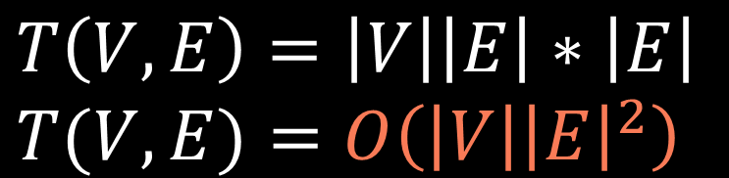
def edmonds_karp(graph):
residual = defaultdict(lambda: {})
for u in graph:
for v, w in graph[u]:
residual[u][v] = w
residual[v][u] = 0
total_flow = 0
while True:
path = bfs(residual, 's', 't')
if path is None:
break
bottleneck = min(residual[u][v] for u, v in path)
total_flow += bottleneck
for u, v in path:
residual[u][v] -= bottleneck
residual[v][u] += bottleneck
return total_flow
$$T\left(V,E\right)=\left|V\right|\left|E\right|∗\left|E\right| \\ T(V,E)=O\left(\left|V\right|{\left|E\right|}^{2}\right)$$
$$\left|V\right|\left|E\right|$$
$$|E|$$

Slide 223
Augmenting paths:
A
0
0
10000
10000
s
t
1
0
10000
10000
0
0
B

Slide 224
Augmenting paths:
A
sAt (bottleneck = 10000)
10000
10000
0
0
s
t
1
0
10000
10000
0
0
B

Slide 225
Augmenting paths:
A
sAt (bottleneck = 10000)
sBt (bottleneck = 10000)
10000
10000
0
0
s
t
1
0
0
0
10000
10000
B

Slide 226
Edmonds-Karp
algorithm

